Slide 1
“What’s Wrong with Hartree-Fock?” -or- “Implementation of Analytic First-Derivatives for Explicity Correlated Gaussian Geminals: Application to Hydrogen Molecule”
Doug Gilmore
Adamowicz Research Group
Physical Chemistry Division
Department of Chemistry
University of Arizona
Division Seminar: Mon/01APR96

Slide 2
“Implementation of Analytic First-Derivatives for Explicity Correlated Gaussian Geminals: Application to Hydrogen Molecule”
Doug Gilmore
Adamowicz Research Group
Physical Chemistry Division
Department of Chemistry
University of Arizona

Slide 3
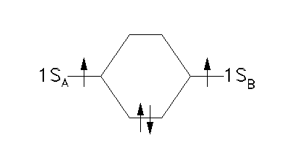
Hartree-Fock Theory:
Essence of HF:
The wave-function is written as a determinant of one-electron orbitals
H.F. applied to molecular Hydrogen:
in atomic units...
under the Born-Oppenheimer approximation...

Slide 4
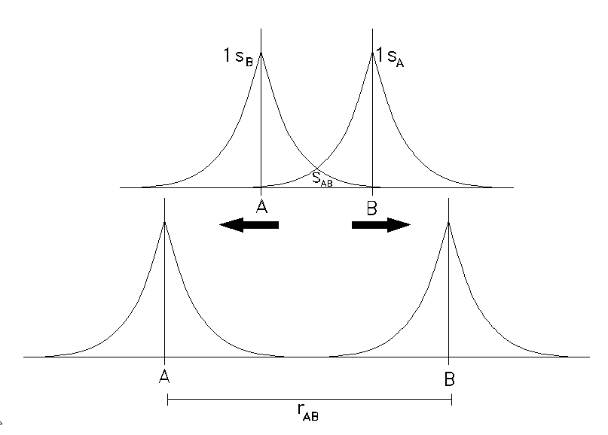
…a double integral over electron coordinates r₁ & r₂
…the one-electron parts of the Hamiltonian
…the two-electron parts
…changing electrons changes the spin
Normalization:
…we have molecular dissociation as S_{AB} goes to zero.
What happens to the Hartree-Fock approach as molecular Hydrogen dissociates?

Slide 5
…a mix of covalent terms and ionic terms.
As r_{AB} approaches infinity; S_{AB} approaches zero, the molecular solution should approach the sum of the atomic solutions...
The Hartree-Fock wavefunction is a poor wavefunction for the
complete description of molecular hydrogen because it ascribes
equal contributions of both ionic and covalent character to the bond
interaction…irrespective of internuclear separation.
That is to say that the Hartree-Fock wavefunction does not allow for
the correct dissociation of the hydrogen molecule because it falsely
predicts the energy required to break the bond.
Hartree-Fock theory suffers this problem for any closed-shelled
system which separates into open-shelled systems.
THERE ARE A VARIETY OF “THEORY PATCHES/UPDATES” TO
DEFEAT THIS PROBLEM WITH HARTREE-FOCK:
Configuration Interaction
Coupled-Cluster Method
MCSCF
Density-Functional Theory
All of the above methods are designed to indirectly account for the
“correlation energy” (that energy which is not picked-up by Hartree-
Fock). But they are not the only ways to account for electron correlation!

Slide 6
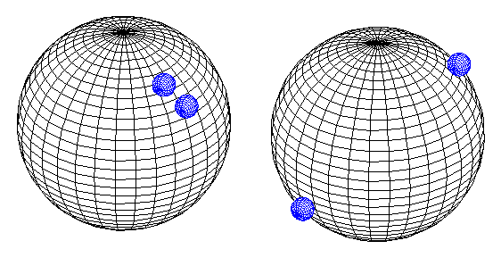
Electron Correlation:
case A
case B
Hartree-Fock Theory evaluates an electron by bleeding the other
electrons out into a field of charge. HF does not account for the fact
that ‘case A’ is much less probable an arrangement for two electrons,
constrained to move on the surface of a sphere, than ‘case B’.
HF predicts that ‘case A’ and ‘case B’ are EQUALLY PROBABLE!

Slide 7
Explicity Correlated Gaussians Geminals:
Standard reference: Boys & Singer [Proc. Roy. Soc. (London) A258,
402 (1960)] with further mathematical development by Lester & Krauss
[Jorn. Chem. Phys., Vol. 41, #5, (1964)].
ECGG’s intrinsically incorporate electron-electron correlation in the wavefunction.
Standard applications:
correlation energy
polarizabilities
Compton profiles
interatomic interaction potentials
Recent applications:
non-adiabatic studies of small systems
accurate multiple moment calculations of H₂ & D₂
It is generally accepted that Hylleraas-type functions more accurately
describe small systems due to the correct reproduction of the electron-
cusp. Gaussian functions do not possess such correct behavior; however,
molecular integrals are much simpler to calculate using gaussian functions
and one is not restricted to such a small molecular system.
ECGG wavefunctions are gaussian product wavefunctions which incorporate
a correlation factor proportional to...

Slide 8
…New in this work is the incorporation of the analytic, first-derivative in the variational minimization of the energy.
The form of the wavefunction utilized is not unique however...
To obtain the ground-state energy, the problem to be solved is...
…with subsequent selection of the smallest eigenvalue. This is not the
only method of obtaining the ground-state energy of molecular hydrogen.
Variational minimization of the Rayleigh quotient will converge to the
ground-state energy as well:
Solution of the energy via the secular equation requires iterative
optimization of the non-linear parameters and then solving for the
corresponding eigenvector (c’).
Iteration on the Rayleigh quotient allows for the linear and the nonlinear
parameters to be optimized simultaneously. Initial work suggests that this
method of optimization may reliably converge to a better value.
The data that is reported here is a result of a Rayleigh quotient
minimization algorythm. The DUMING (double-precision, uncon-
strained, multivariant, quasi-newton method with user supplied analytic
gradient) IMSL optimization library was used.
Previous work has utilized Powell conjugate gradient and random
tempering procedures for wavefunction optimization.
Lets take a look at some of the properties of the explicitly correlated GG’s...

Slide 9
MATHEMATICA STUFFF...

Slide 10
Notation:
…one-dimensional cartesian gaussian
…general cartesian gaussian
…for a cartesian gaussian geminal (GG)
This last equation can be rewritten as a product of three one-dimensional GG’s:
DERIVATIVES:
Rigorous analytic derivatives are provided-- however, it should be noted that the
results reported were obtained via the more situationally expedient method of
direct analytic differentiation of the fortran code with the aid of Mathematica.
Differentiation with respect to orbital exponents:
Differentiation with respect to correlation exponents:
…and slightly more complicated when replacing the right-hand side by the
appropriate combination of cartesian gaussians...

Slide 11
We can rewrite as a sum of two gaussians...
Multiple application of this expansion to the derivative with respect to the
correlation exponents leads to the following… (for breivity, only part of the
expression is presented. The rest can be easily generate)
Differentiation with respect to linear coefficients...
Differentiation with respect to orbital centers:
Notation continued...
…this will represent the common center of two gaussians.
This becomes helpful in the reduction of the six-dimensional
overlap integral to the simpler three-dimensional form.

Slide 12
The product of two gaussians can now be expressed as...
For general cartesian gaussians, we can expand the polynomial of the coord-
inates and the centers with respect to the common centers...
The final product takes on the form...
Normalization of the wavefunctions is incorporated in the calculation
of the S matrix in the following fashion...
The overlap matrix and the hamiltonian matrix have to be setup in the
usual way...
…this six-dimensional integral is easily reduced to a three-dimensional
integral and is subsequently expressed as a ratio of mixed determinants
and pure determinants multiplied by an exponential...

Slide 13
Additionally, as with the rest of the molecular integrals, a symmetry
projector is applied to the ket….
In general, the derivatives of the molecular integrals are calculated in
the following manner...
…this procedure can be applied to the overlap integral, nuclear attraction
integral, and the electron repulsion integral. It cannot; however, be
applied directly to the kinetic energy integral. The kinetic energy integral
must first be expressed in terms of the overlap integrals and then the
above procedure can be implemented. The derivative of the nuclear-
nuclear repulsion integral is zero in that we are utilizing the Born-Oppen-
heimer approximation.
The Overlap Integral:
The overlap integral for gaussians can be expressed as a product of
three one-dimensional integrals. For the ground-state of molecular hydrogen,
we are only concerned with the spherically symmetric part of the integral.
Using the relations for derivatives of GG’s presented previously we have...

Slide 14
The gradient of the energy functional is compiled in the following
manner...
This is a sparse-matrix representation which can be densified...
The gradient of the energy can now be represented by...
And now-- some very preliminary results...

Slide 15
NUMERICAL RESULTS:
This code has only been made operational one week ago. These results
represent very preliminary calculations:
GG RESULTS (past & present):

Slide 16
SIGMA PLOT GRAPHS...

Slide 17
TOP-10 DIRECTIONS FOR FUTURE WORK:
10. take a short break from coding to get a better grasp of the rigorous
development of the theory (...and to de-alienate my fiance’)
9. investigate potential advantages of a parallel (SMP) approach
8. rework the fortran code in the matrix calculus formalism (D. Kinghorn)
7. rework the fortran code into full F90 specification (already
incorporates dynamic memory allocation)
6. attempt to characterize criteria for better convergence based on
starting point of the optimization (looks bleak… nonlinear
optimization is a difficult problem- initially appears to be
very random in nature)
5. quantitatively compare different gradient optimization algorythms
(TN, variable metric & other in-house routines.)
4. quantitatively compare gradient optimization to non-derivative based
optimization routines [DUMING vs. DUMINF] This can be
done easily for small basis sets
3. run for HeH⁺ and H₃⁺ and possibly systems of higher angular momentum
2. incorporate the cylindrically-asymetric coordinate center derivatives
(derivatives with respect to x & y)
1. run for larger basis sets, get numbers & publish paper

Slide 18
My appreciation is extended to all of the members of the Adamowicz
research group:
Will McCarthy
Yasser Elkadi
Vadim Alexandrov
Dayle Smith
with special consideration to...
Dr. Ludwik Adamowicz
Dr. Don Kinghorn

